Slide 1
Computer Graphics (L09) EG678EX
3-D Transformations

Slide 2
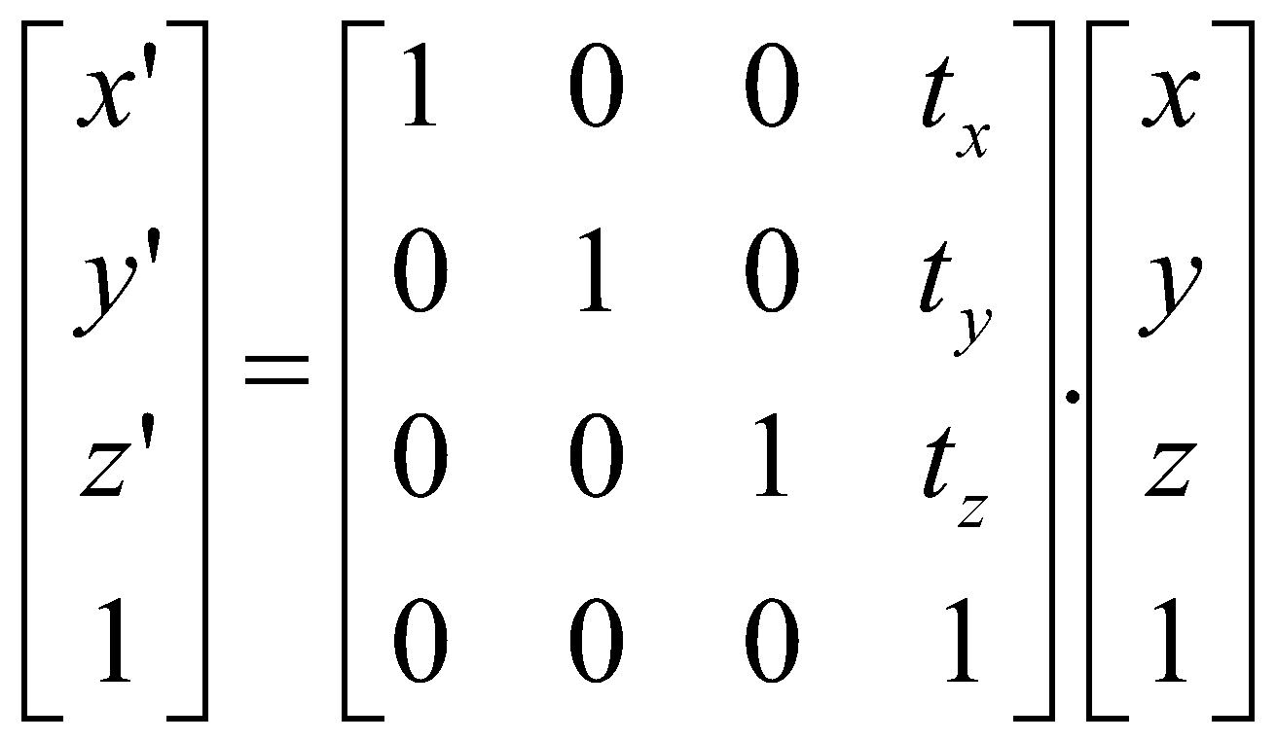
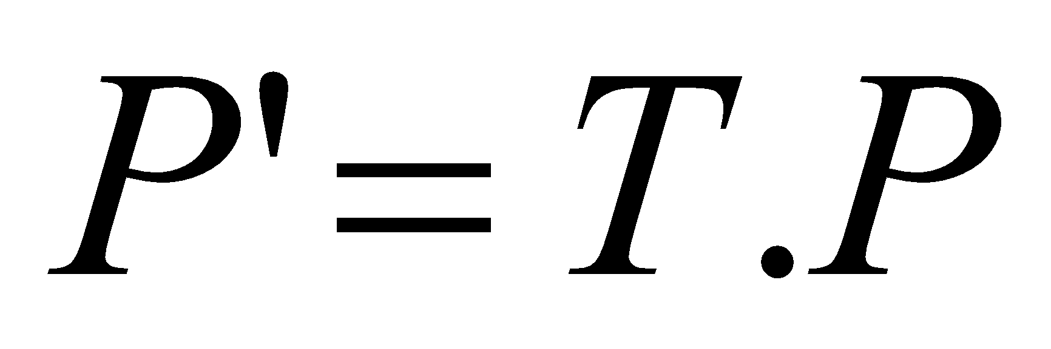
Translation
x’ = x + t_{x}
y’ = y + t_{y}
z’= z + t_{z}

Slide 3
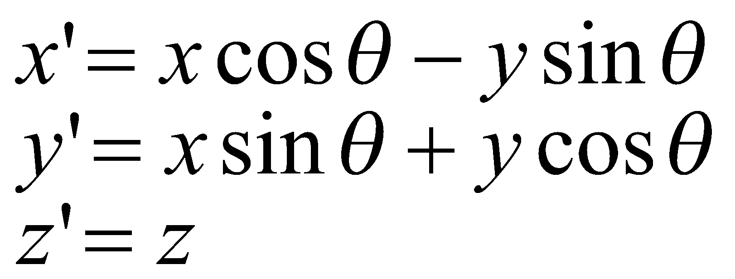
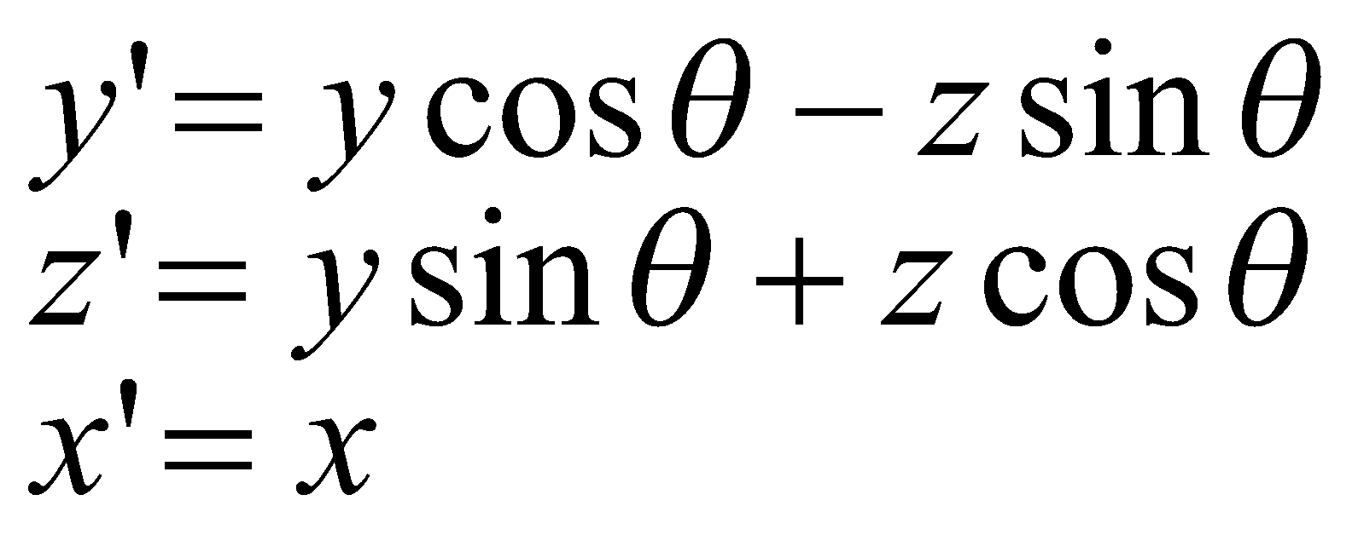
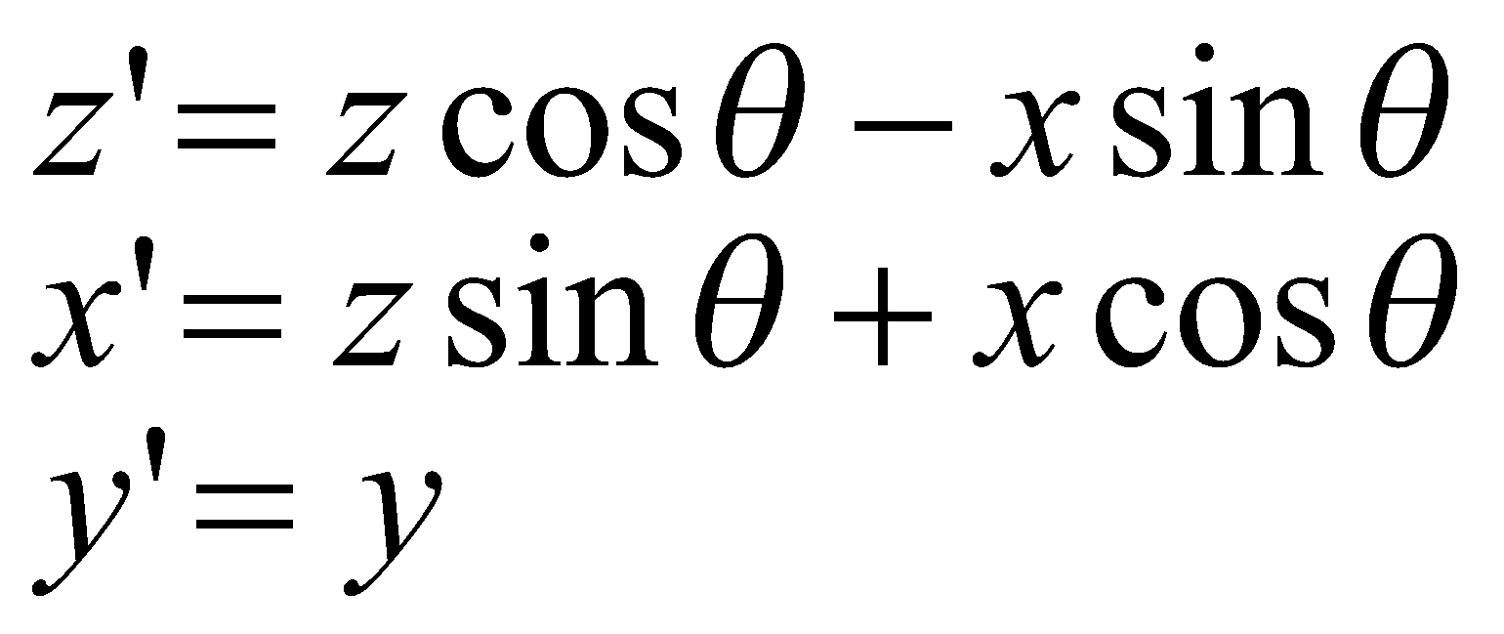
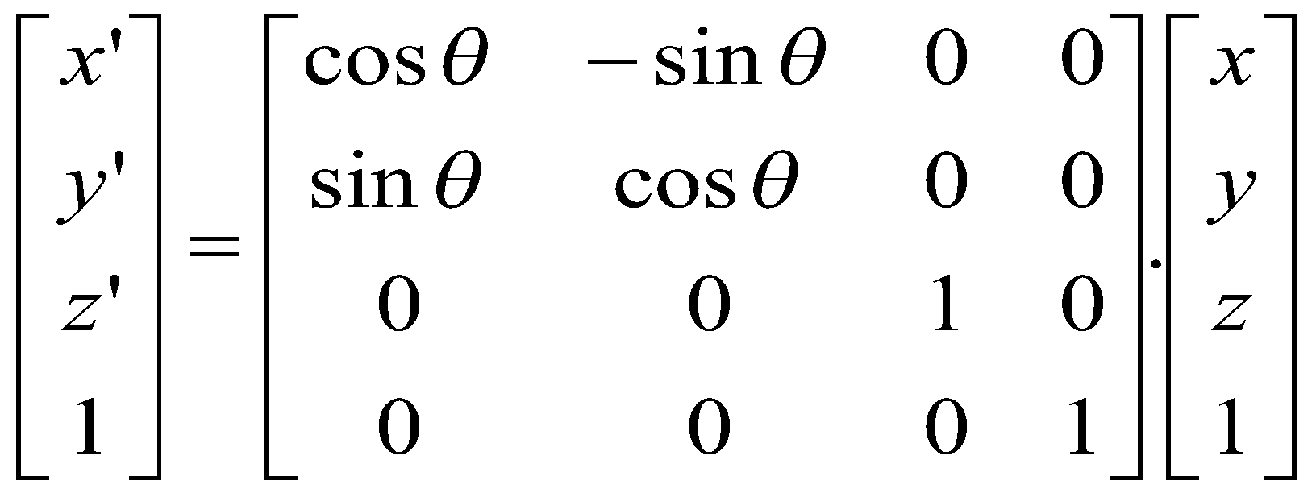
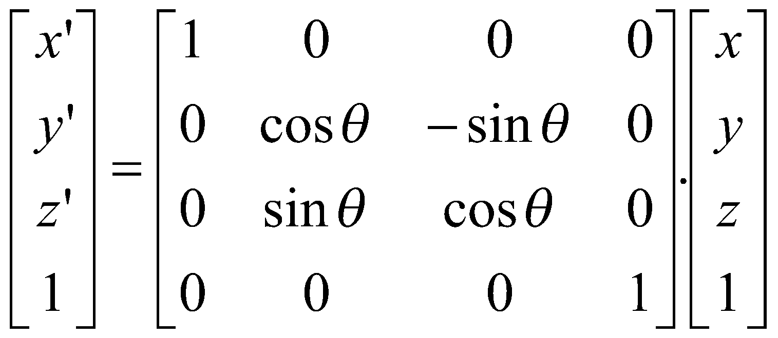
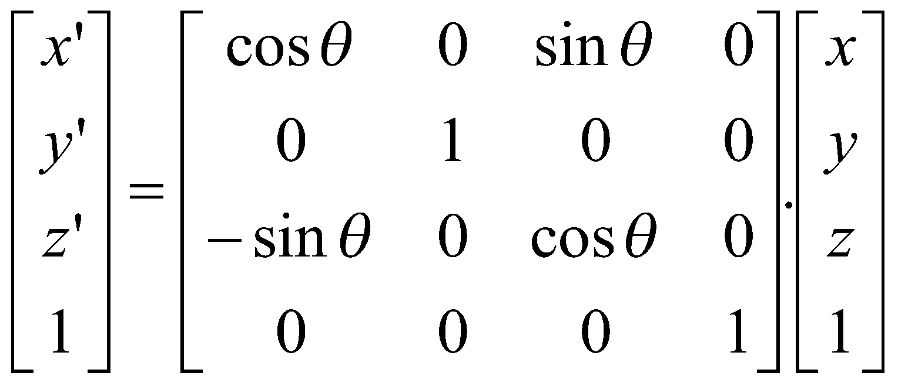
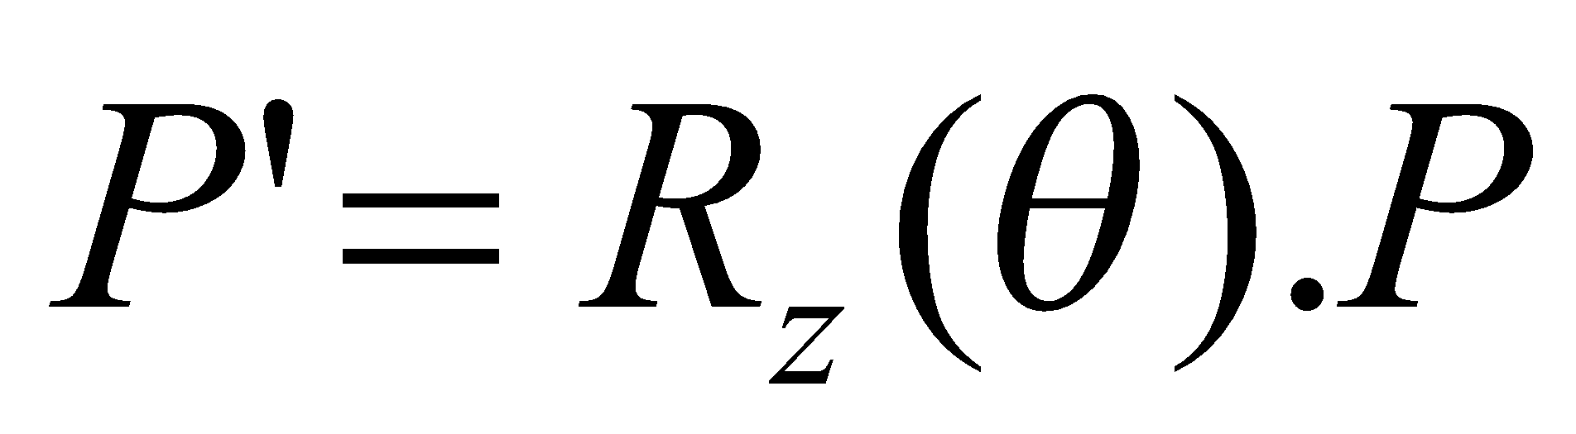
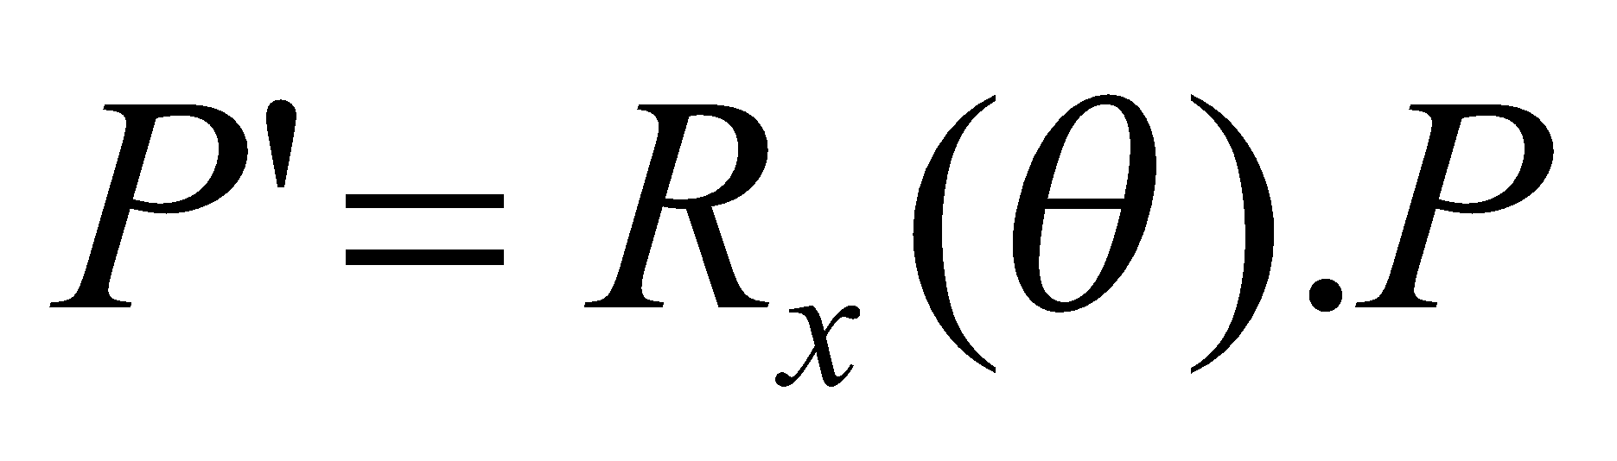
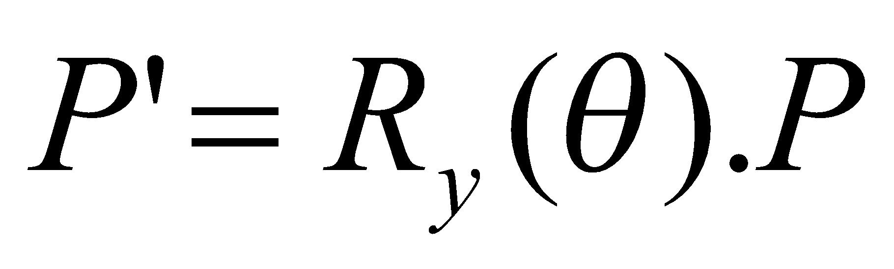
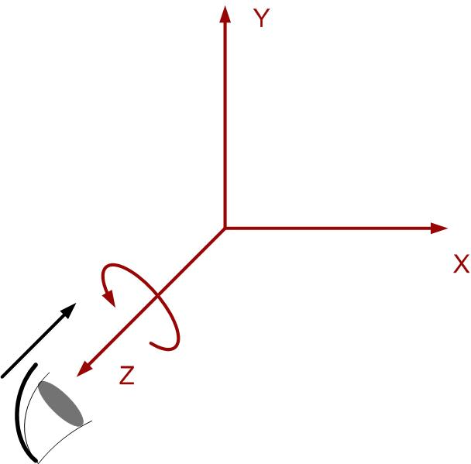
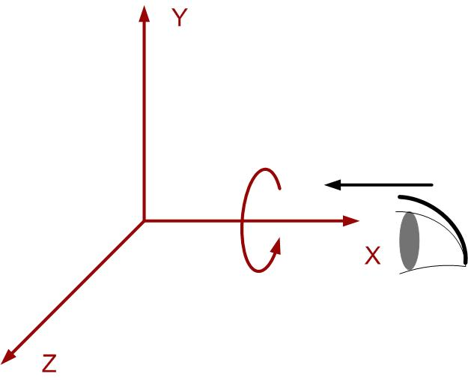
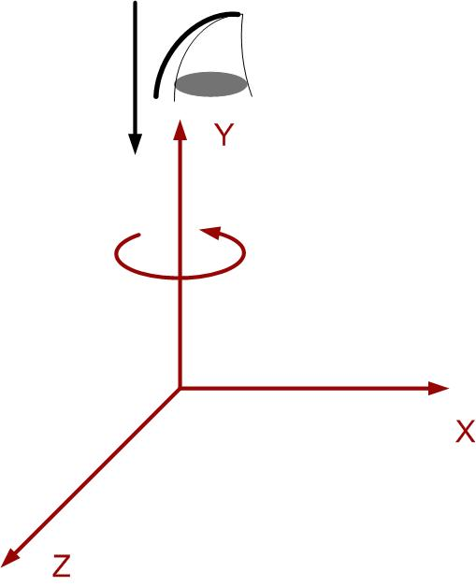
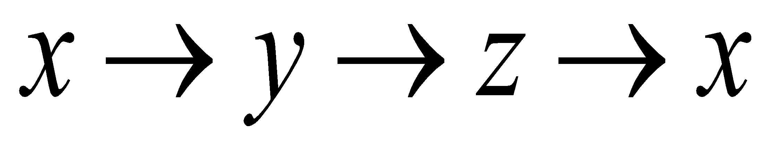
Rotation (about co-ordinate axes)
Remember The cyclic order:

Slide 4
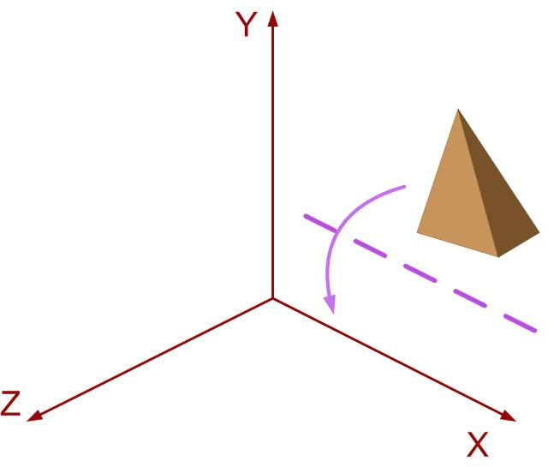
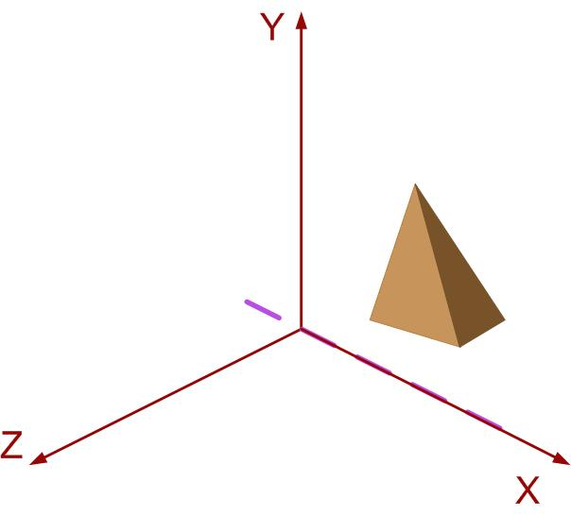
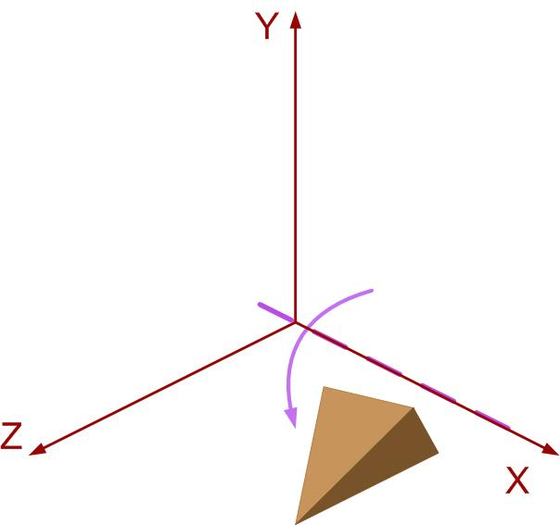
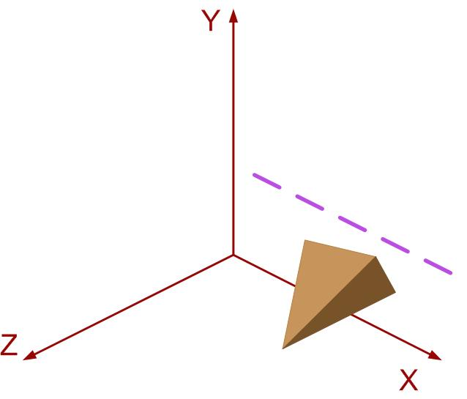
Rotation about axis parallel to co-ordinate axis
x
Steps
Translate the object so as to coincide rotation axis to parallel co-ordinate axis
Perform the rotation about the axis
Translate back the object so as to move rotation axis to original position
Step 1
Step 3
Step 2

Slide 5
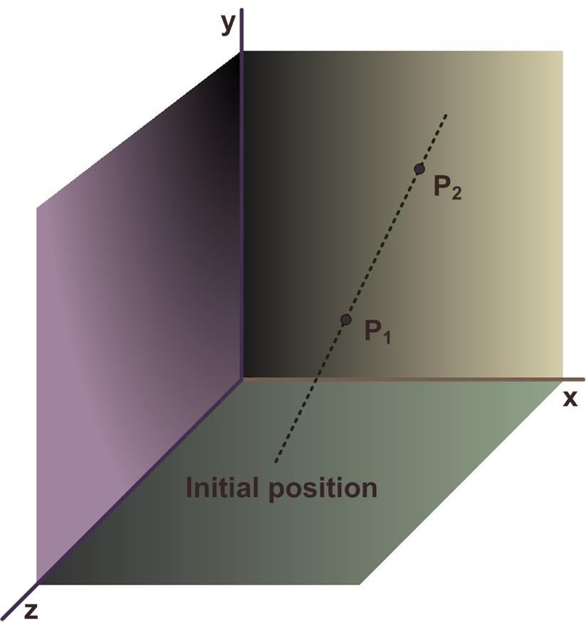
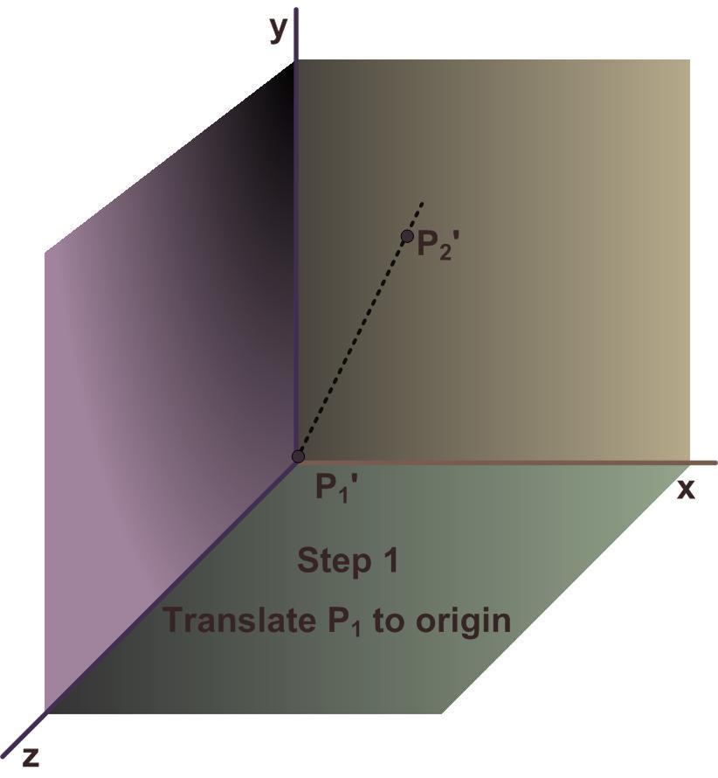
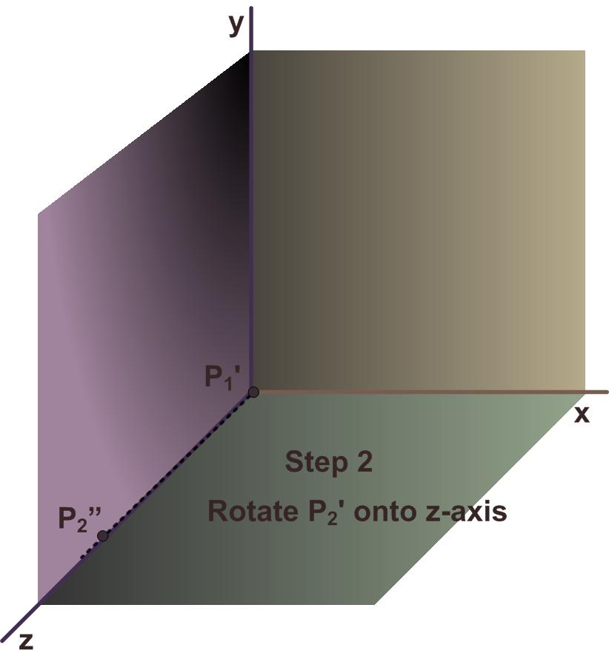

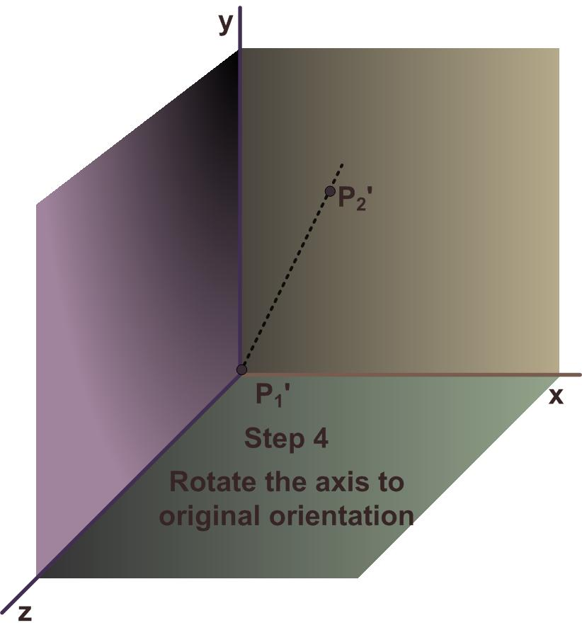
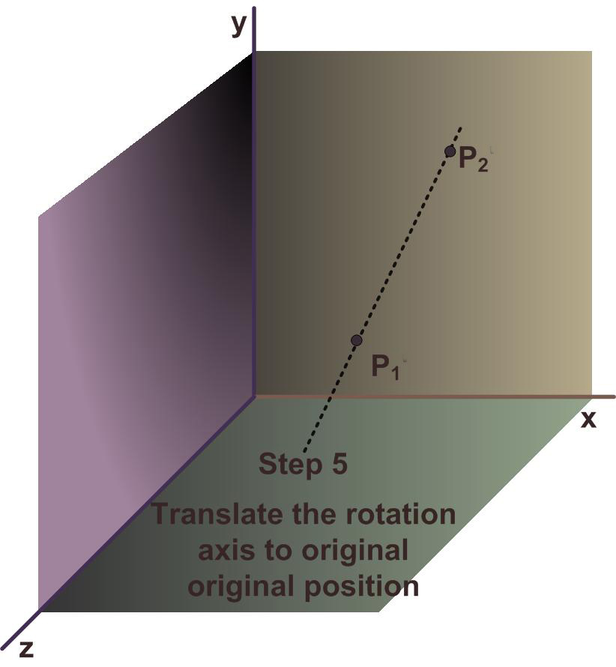
General 3-D Rotation

Slide 6
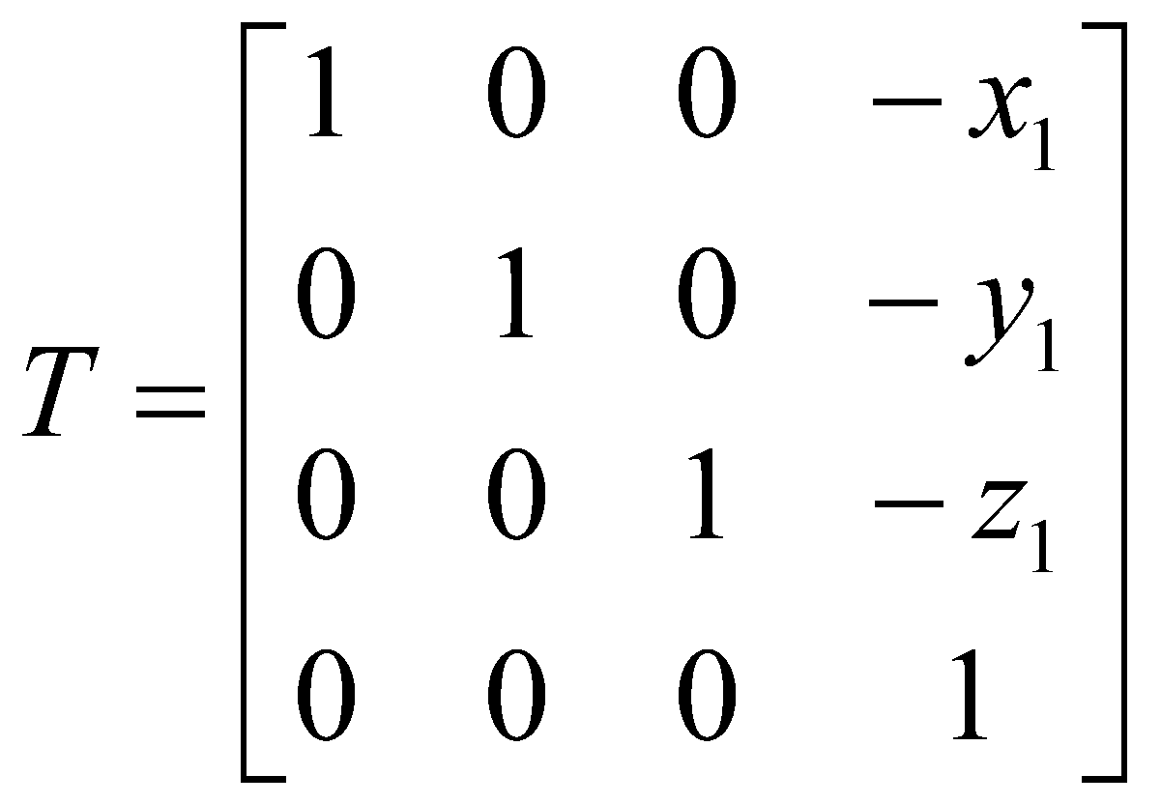
General 3-D rotation Mathematics
Step 1
Translate object so as to coincide P₁ to origin

Slide 7

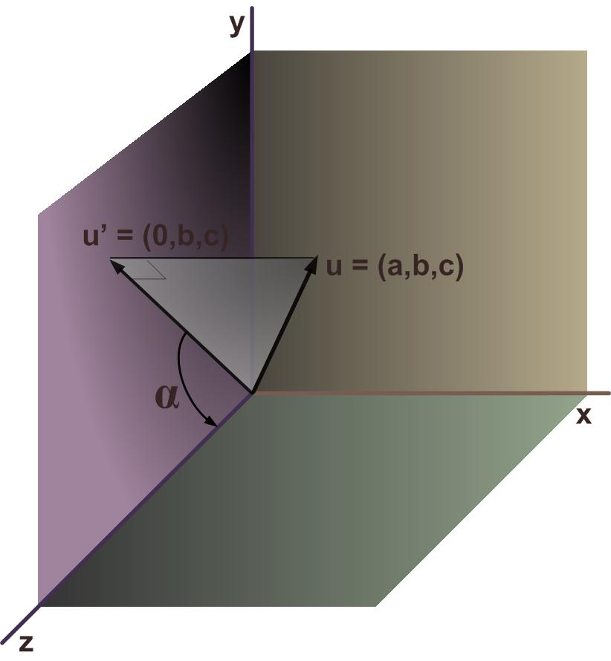
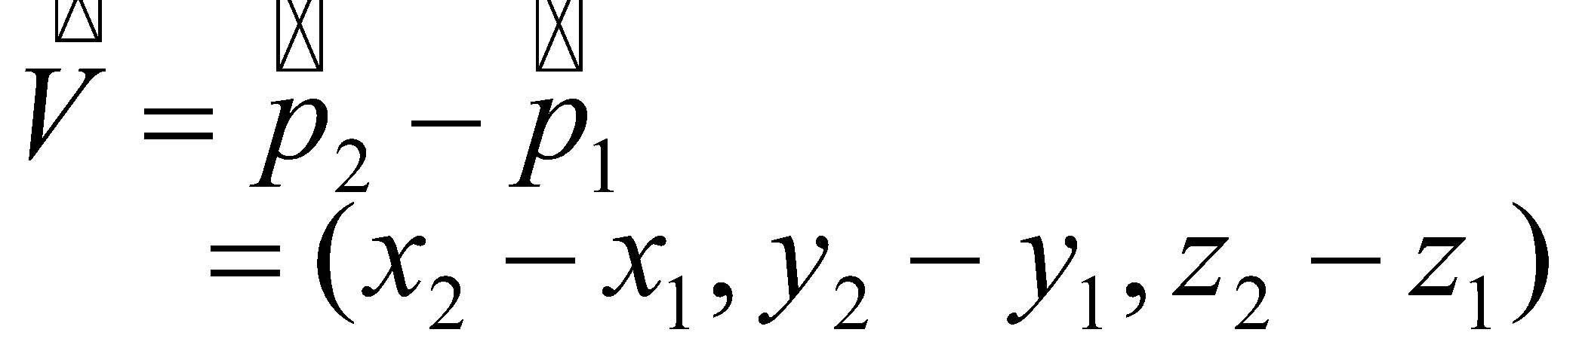
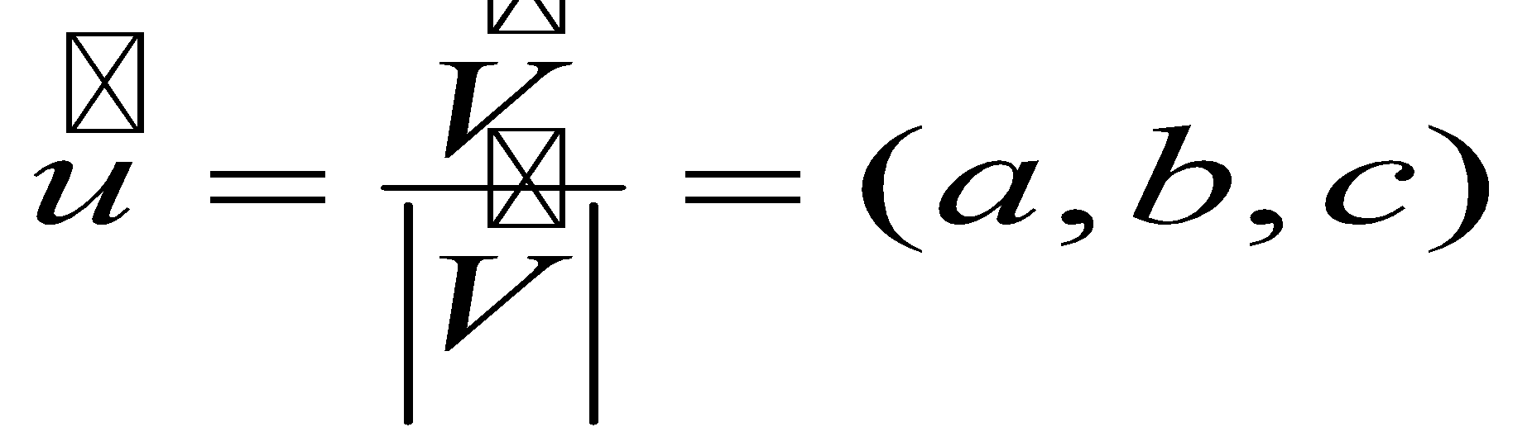
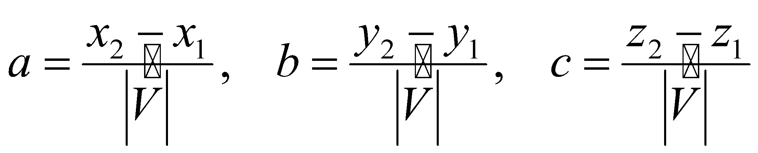
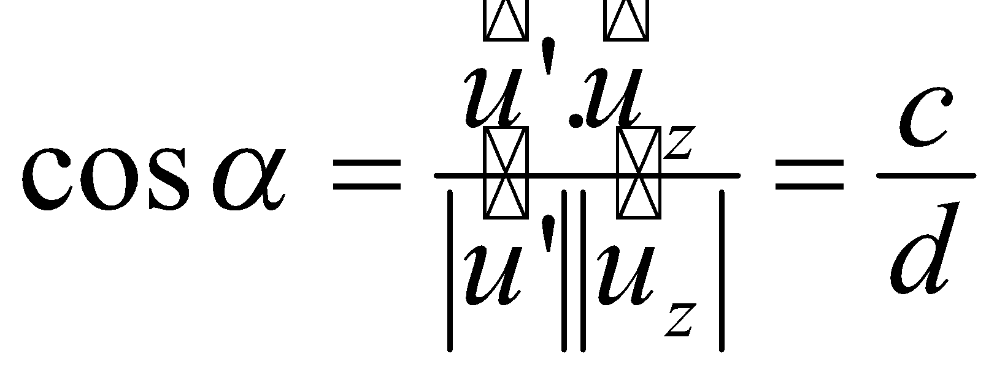
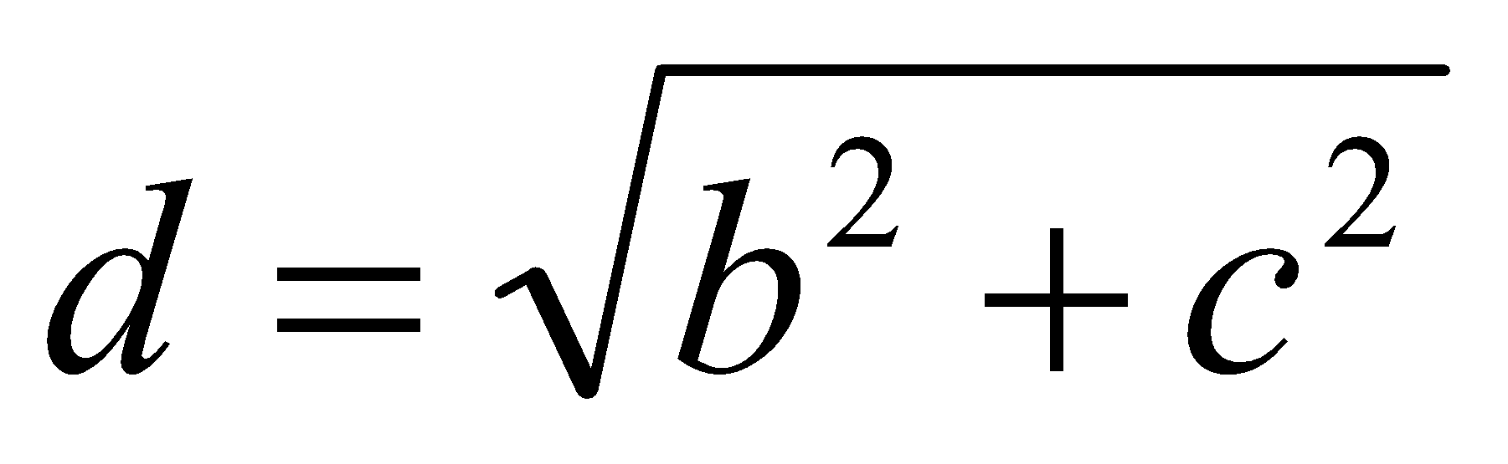
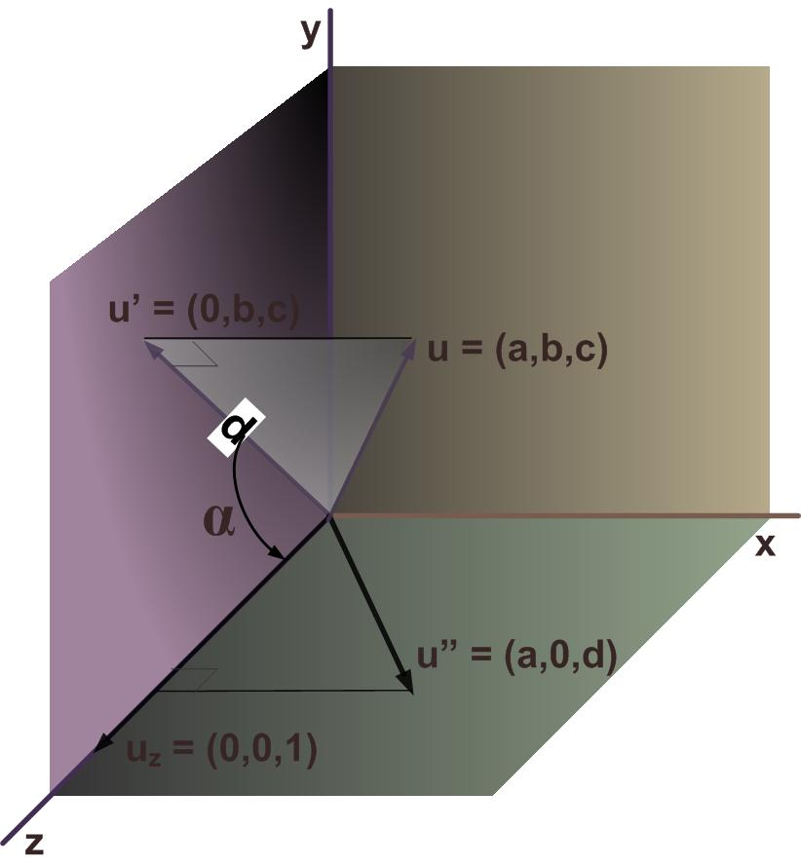
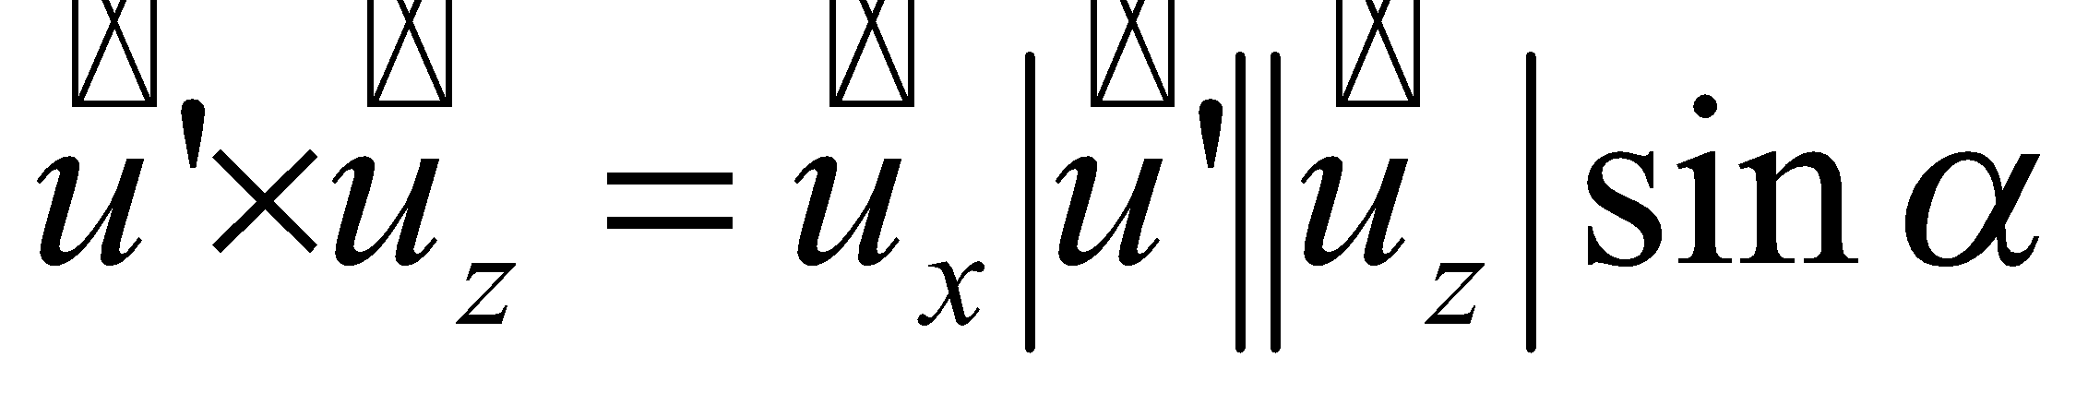
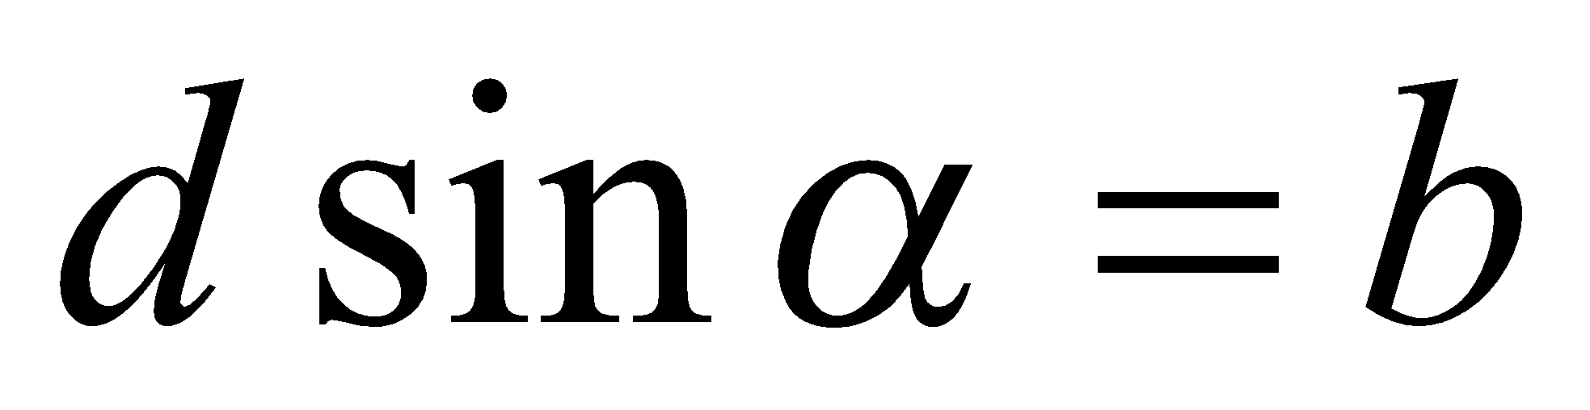
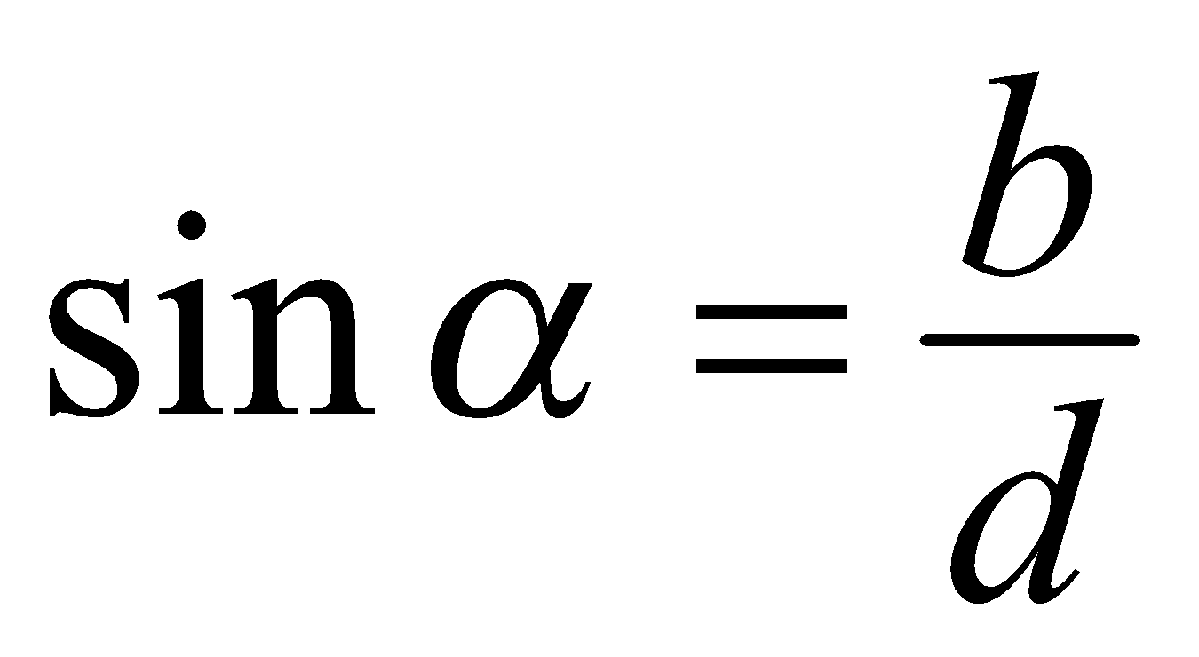
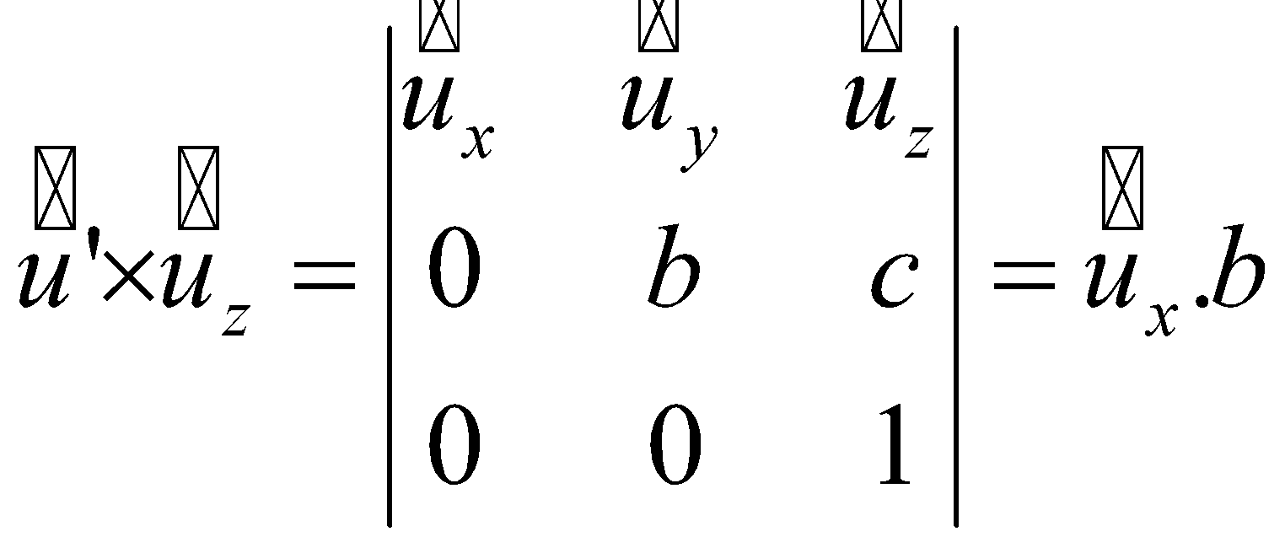
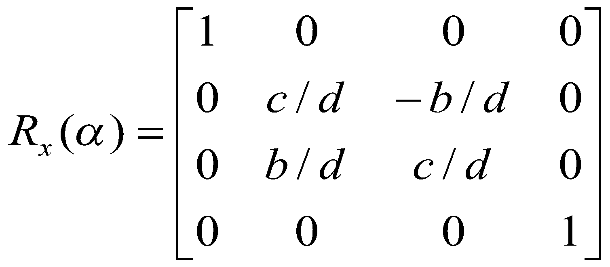
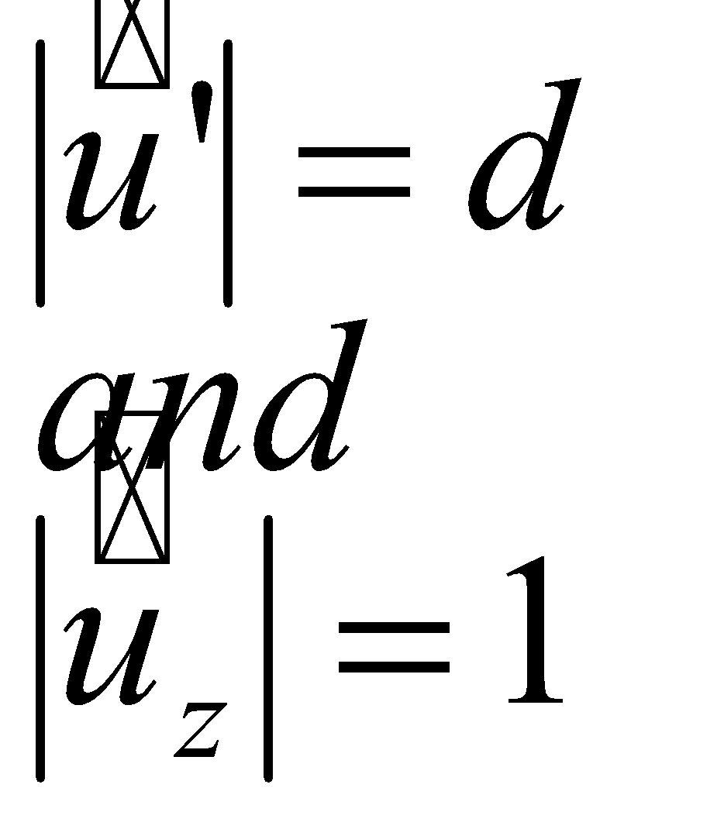
General 3-D Rotation Mathematics
X- Axix rotation (α)
Step 2
Accomplished in two steps
Perform x axis rotation with angle α so as to bring rotation axis to zx plane
Perform y axis rotation with angle ß so as to coincide the rotation axis with z-axis

Slide 8
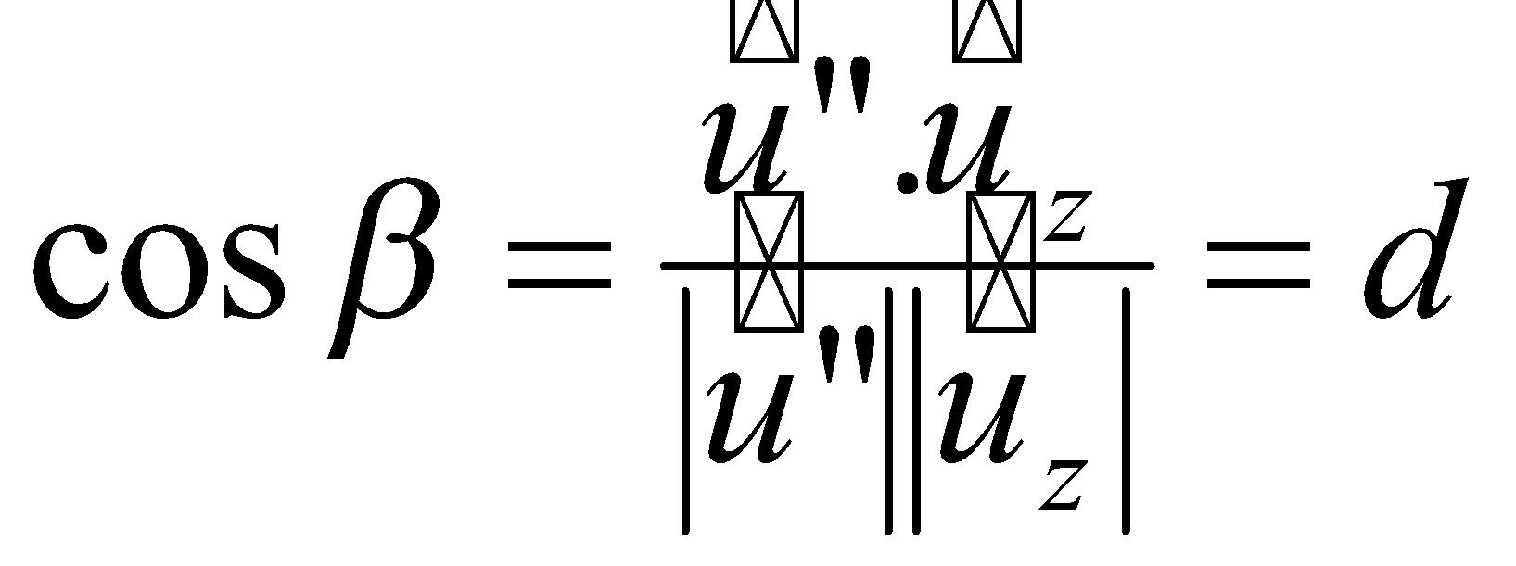
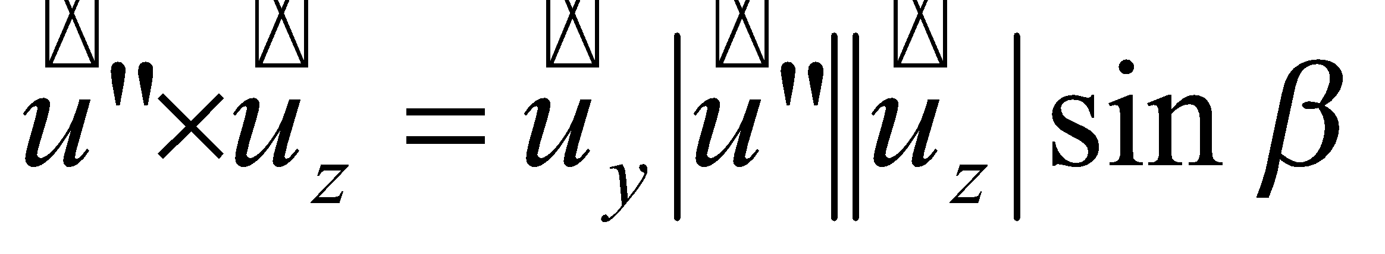
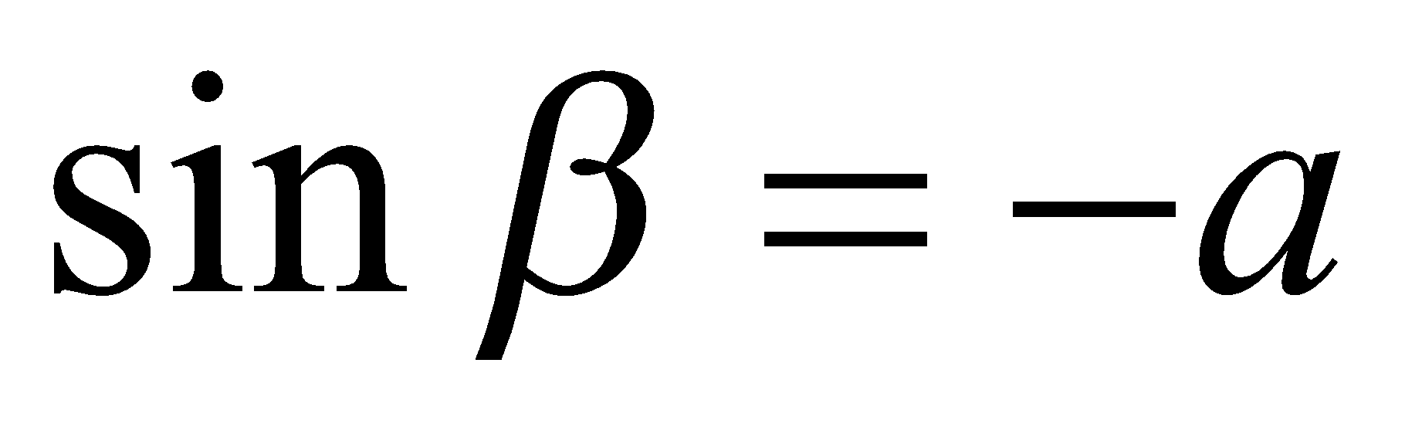
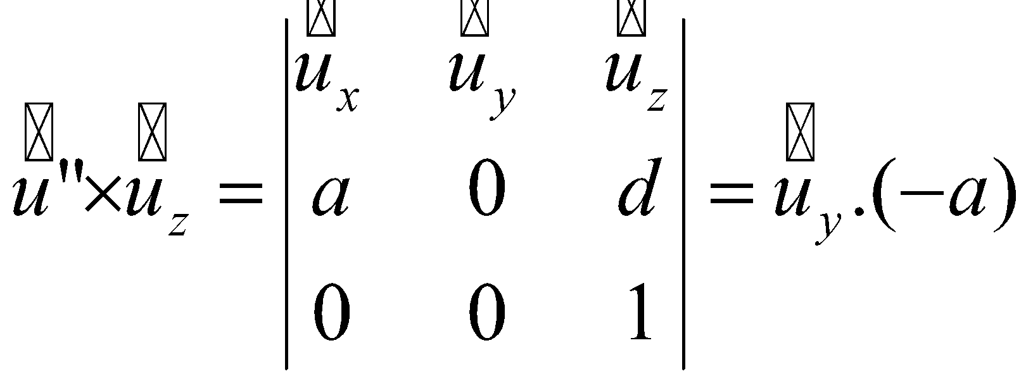
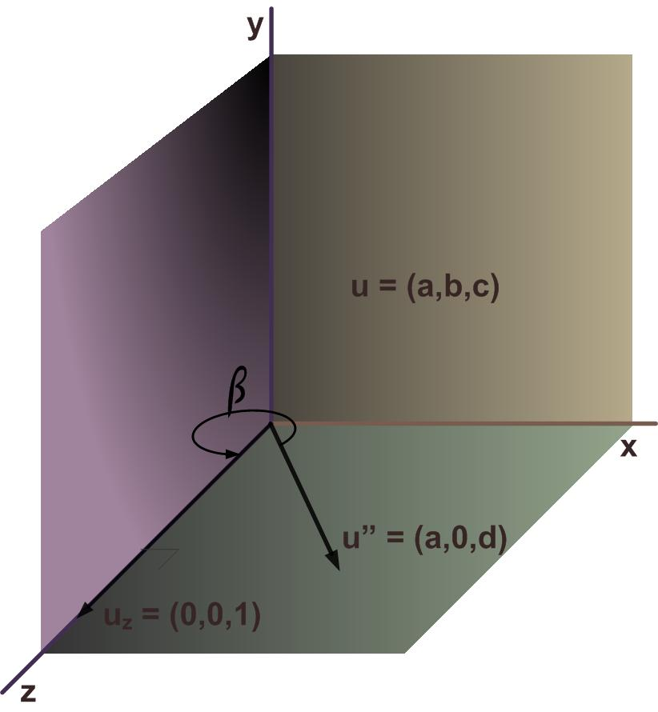
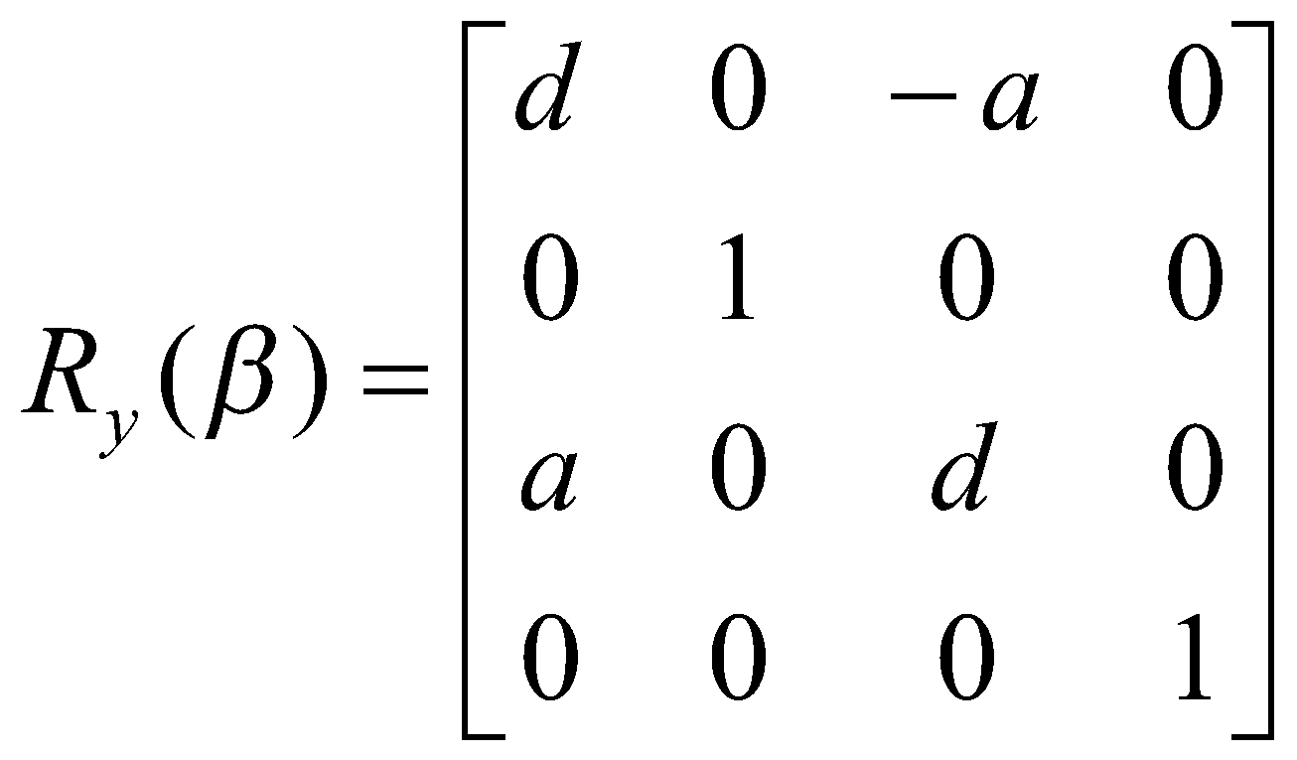
General 3-D Rotation Mathematics
Y-Axis Rotation (ß)

Slide 9
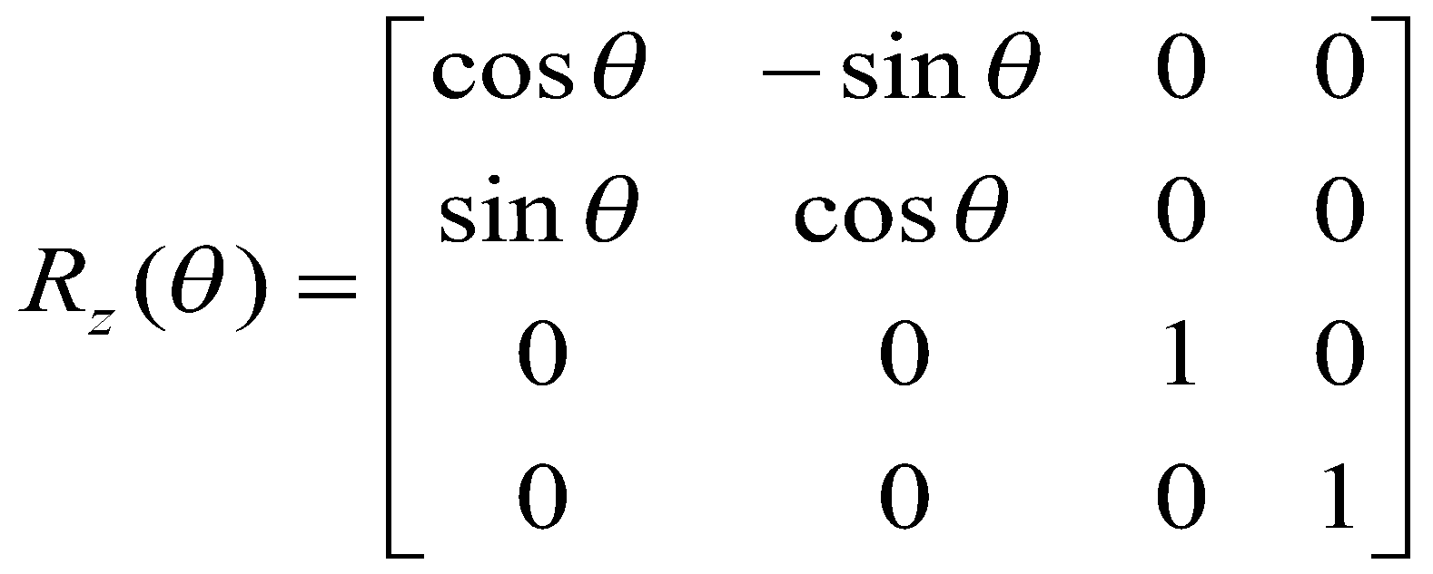
General 3-D Rotation Mathematics
Step 3
Perform z-axis Rotation with angle θ (the angle which the object is to be rotated about the given axis)
Step 4
Perform inverse Rotation and i.e R_{x}⁻¹(α) and R_{y}⁻¹(ß)
Step 5
Perform inverse Translation i.e T⁻¹
Final composite Matrix is obtained as:

Slide 10
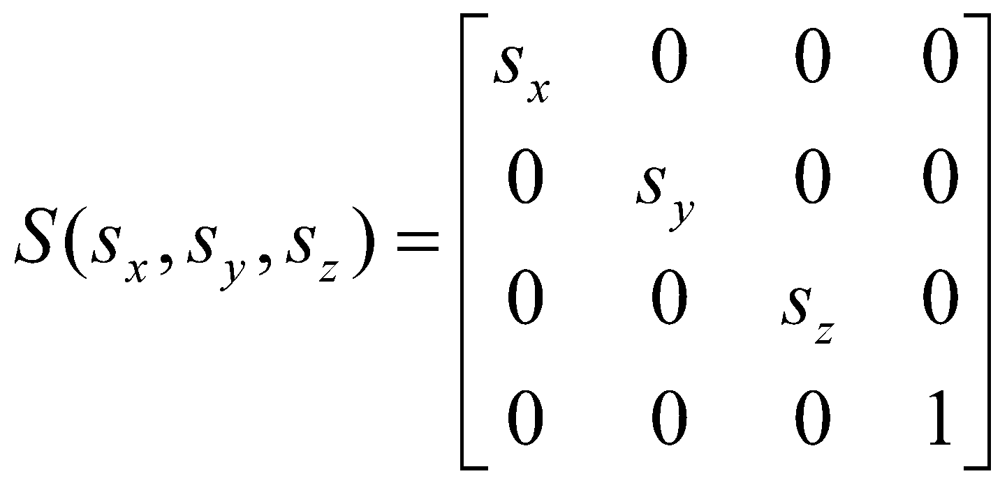
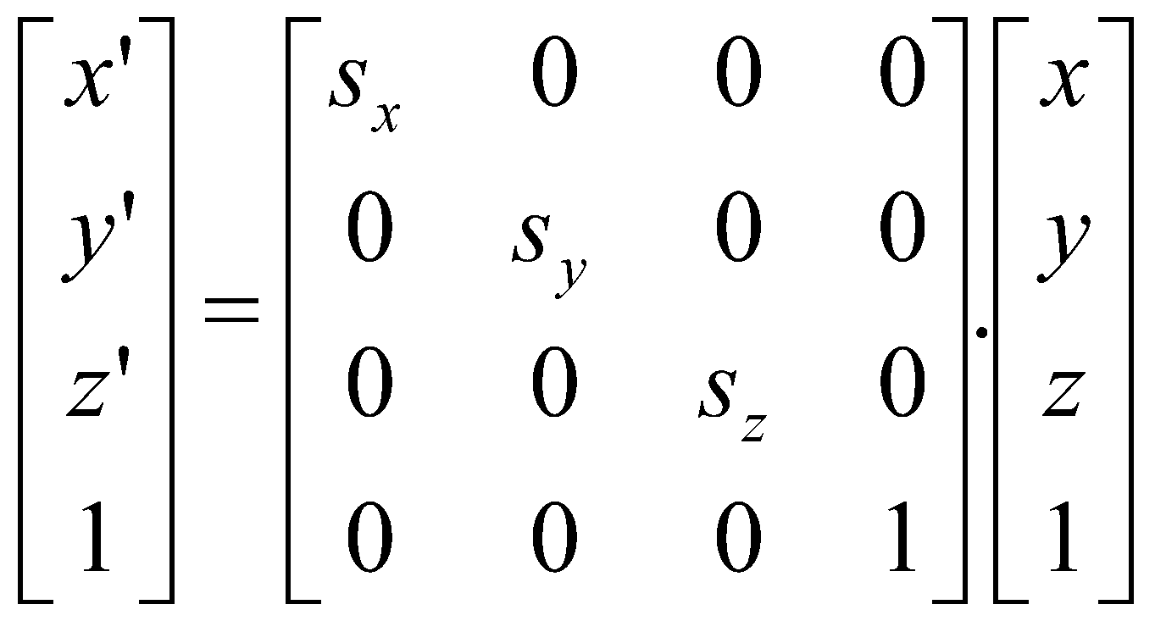
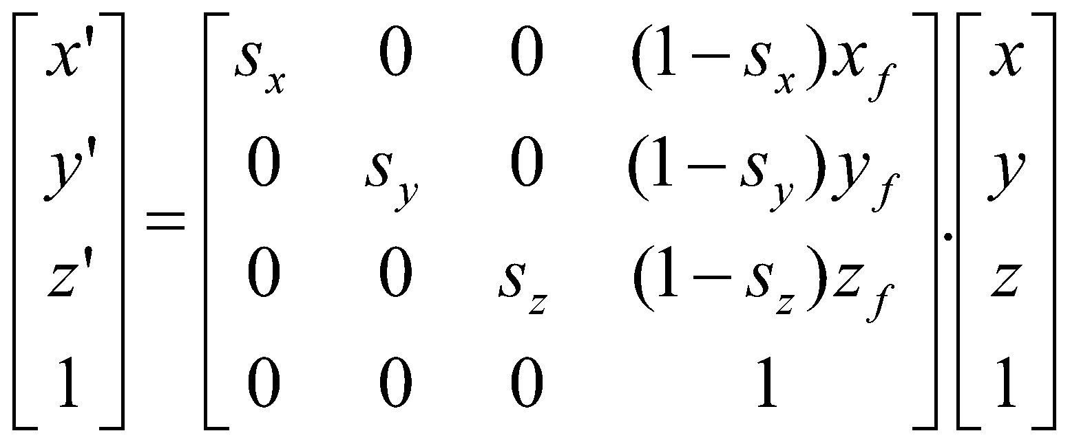
3-D Scaling
Scaling about origin
Fixed Point Scaling

Slide 11
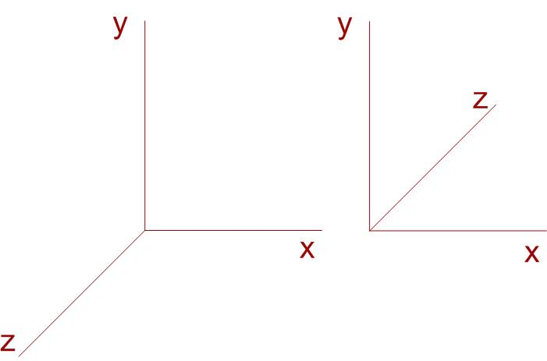
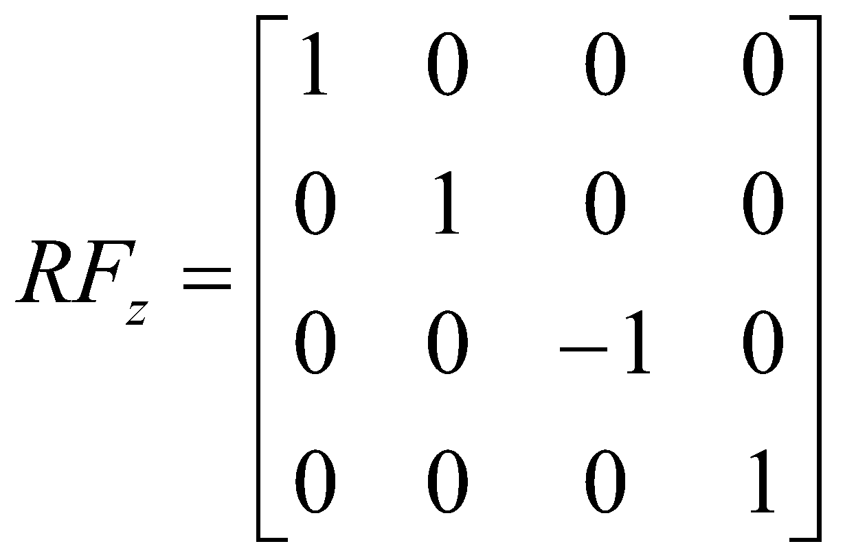
3-D Reflection
Performed relative to a reflection axis or reflection plane
Axis reflection🡪 equivalent to 180 degree rotation about the axis in 3-D space
Plane reflection 🡪 equivalent to 180 degree rotation in 4-D space
4-D space ?? 🡪 not visualized in euclidian space
Reflection about a plane converts right handed co-ordinate system to left handed co-ordinate system and vice versa
Reflection in xy plane
x’ = x
y’ = y
z’ = -z
Matrix is as

Slide 12


3-D Shear
Z-axis shear
x’ = x + a.z
y’ = y + b.z
z’ = z

